Slide 1
ASIS Academy
Automation by Scripting
Adam Shackleton

Slide 2
Course Agenda
1. Introduction to Python
- What is scripting; Why Python; Lighting Python lesson
2. Introduction to Automation
- What do we mean by automation; Interacting with files and the file system
3. APIs
- What’s an API; How to access them using Python
4. Databases
- Lighting SQL lesson; Creating and using database connections
5. Excel Files
- Pandas; Common Excel functions in Python

Slide 3
Today’s Agenda
What do we mean by automation?
Python tasks
Review of last week’s challenges
Importing from the standard library
Namespaces
Interacting with the file system
Running scripts on a schedule
Code challenge
Homework
Notes:
If you have questions throughout please put them in the chat and if anyone knows the answer they’re welcome to help me out, otherwise I’ll sweep them up before we go into the exercises
This isn’t a Python course – it’s a course about using python so the pace might be a bit fast – rest assured all the code I show as examples will be available when you’re working on the exercises

Slide 4


Tools we’ll use during our sessions
Python 3.10
VS Code
https://www.python.org/
https://code.visualstudio.com/

Slide 5

What do we mean by automation?
Removing some manual activity either for the purpose of speeding up the time taken to complete it, reducing the likelihood of human error, or most usually, both.
Writing a script that replicates a set of steps that would otherwise be done by a user.
Notes:
From this point on, we’ll be looking a common tasks lab users might perform and some tools we can make use of to make them more automatic

Slide 6
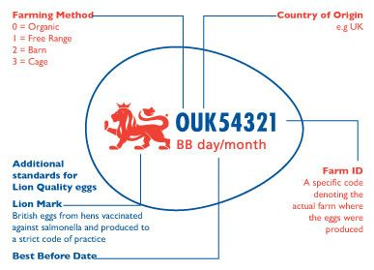
A look at some of the challenges from last week

Slide 7

Python – Standard library
Last week we only used the very limited set of features and functions that are available when we initially run Python.
There are a large number of additional functions implemented in libraries that come with Python but have to be explicitly included in our code in order to be used.
These are frequently referred to as “The Standard Library”
They are included in your code using the keyword “import”
There are ~70 libraries in the standard library covering mathematical operations, regular expressions, random number generation, additional data types, and many more
Notes:
Common types – int, long, string, Boolean
Opposite of Duck Typed is strongly typed
If you’re curious, these code blocks are from something called a Jupyter notebook

Slide 8



Python – Namespaces
In simple words, a namespace is a collection of names and the details of the objects referenced by the names.
A namespace is a way of defining which group of objects an function of interest belongs to. They allow a logical separation and make it clear in our code what we imported and what we built.
If you simply import a library, then you’ll access
any functions in that library like this:
But if specify the exact function to import
then access will be like this:
You should never do this:
Notes:
You can import multiple functions or objects from a library by doing
From library import this, that, the_other
The libraries quite often contain a large number of functions and if you import them all without the namespace safety net, you run the risk that one of the functions in the library will clash with one that you have written, which is a particularly tricky bug to find

Slide 9
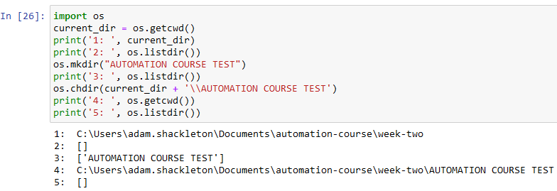
Python – Interacting with the operating system using the os library
The os library contains lots of functions which allow us to navigate and interact with the operating system of the machine our code is running on.
This includes making and deleting directories, listing files, creating, copying, and moving files, etc etc

Slide 10
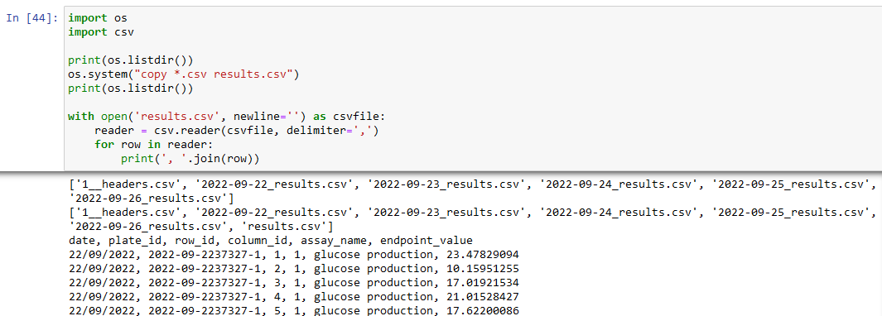
Python – Interacting with the operating system using the os library
Another thing we might want to do in the operating system is call the windows / unix command line
Notes:
The subprocess library is probably a better way to call the command line, but for demonstration purposes os.system works

Slide 11
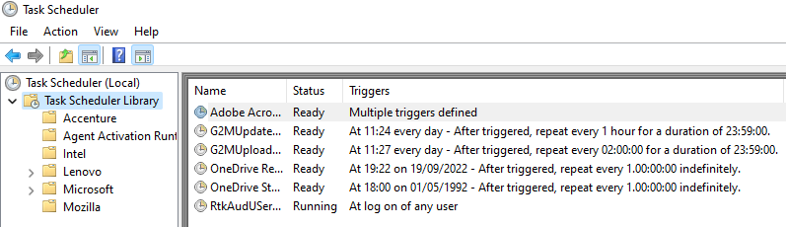
Running scripts on a schedule
In order to automate a process, we need to be able to trigger it to run without human intervention.
A very common way to do this is to schedule the script to run on a regular basis
The process for this varies between operating systems, but we’ll focus on Windows for this course using task scheduler

Slide 12
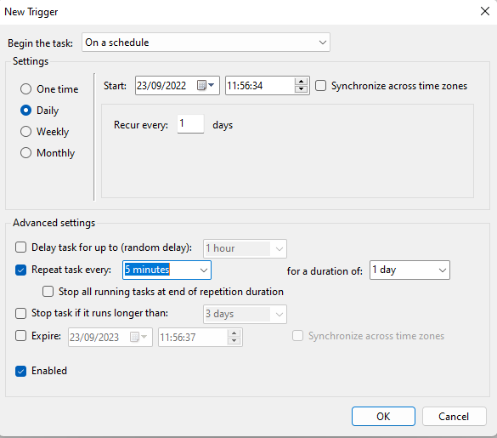
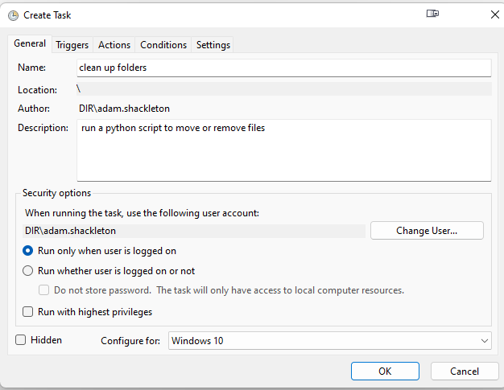
Running scripts on a schedule

Slide 13
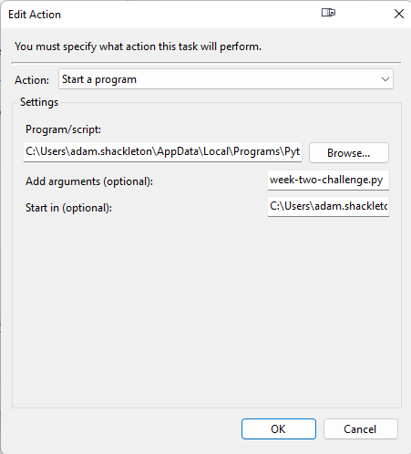
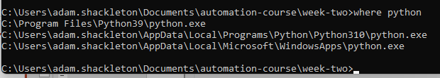
Running scripts on a schedule
Program/script is your python location
Add arguments (optional) is your file name
Start in (optional) is the location your python file is stored in
Be careful about paths that had a space in them, this will need to be in “C:\Users\adam\Folder with spaces”

Slide 14
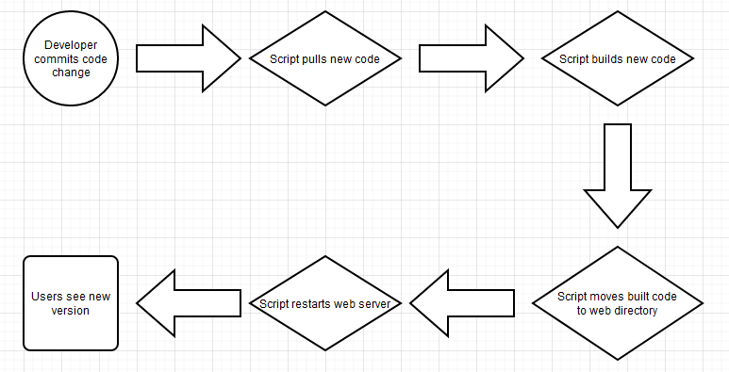
Real life example

Slide 15
Thank You

Slide 16
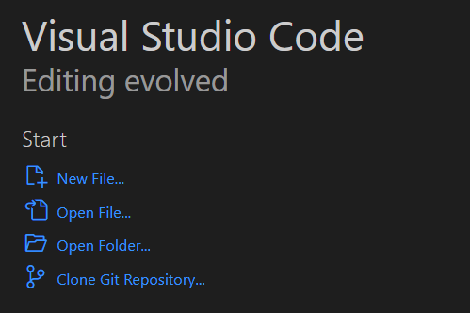
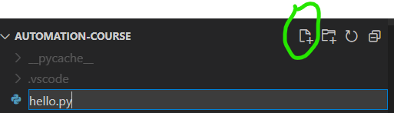
Checking it’s working – Hello World
Once Python and VS Code are installed, create a folder to hold your code and then open VS Code
When it opens, click Open Folder… and select your desired location
From the Explorer, click the new file icon and call it hello.py

Slide 17
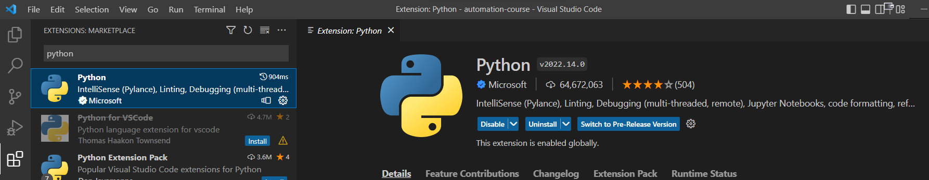
Checking it’s working – Hello World
There’s a good chance VS Code will recognise that you are running a python file and ask you to install the python extension, if not, go to the Extensions icon and search for it
Click the blue install button (shows as “Uninstall” in my screenshot)

Slide 18
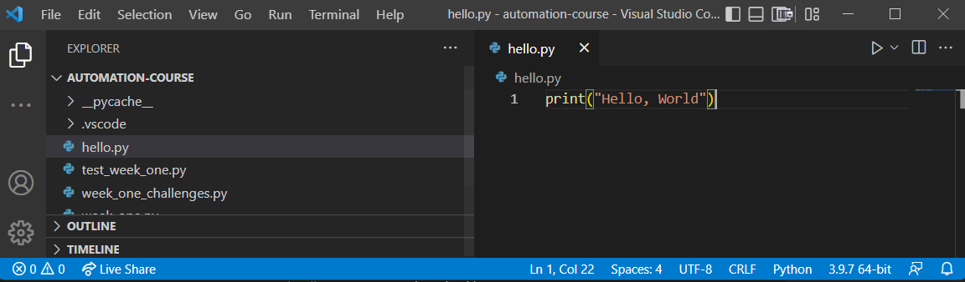
Checking it’s working – Hello World
Once that’s done, go to your hello.py file and type print(“Hello, World”)
Check that VS Code has recognised you have a Python interpreter, shown here as 3.9.7, and click the play button in the top right corner

